Slide 1
TRACEFINDER – FORENSIC SCANNER IDENTIFICATION SYSTEM
AI-Based Source Identification

Slide 2
Introduction
Every scanner leaves unique digital fingerprints in scanned documents
These patterns can be analyzed using Artificial Intelligence
Helps identify the source scanner for forensic and legal investigations
Provides an automated and reliable solution for document verification

Slide 3
Forensic Scanner Identification
Determines the scanner brand or model used to digitize a document
Analyzes unique noise patterns and scanning artifacts as digital fingerprints
Supports digital forensics, document authentication, and legal investigations

Slide 4
Scanner Identification Challenges
- Scanner noise patterns are very subtle and difficult to distinguish
- Variations in resolution, lighting, and document quality affect accuracy
- Large and diverse datasets are required for reliable classification
- Similar scanner models produce overlapping features

Slide 5
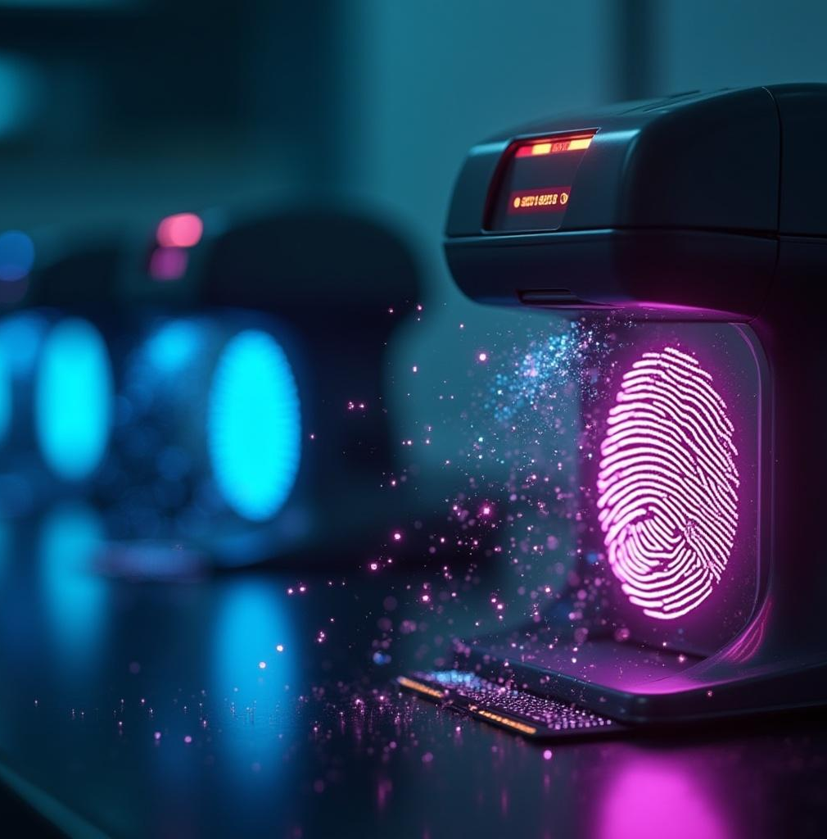
Importance of scanner-specific noise patterns
Each scanner produces unique noise patterns that act as digital fingerprints
These patterns help distinguish between different scanner devices
Essential for accurate scanner source identification
Strengthens document authenticity and forensic evidence analysis

Slide 6
Limitations of manual identification methods
Manual scanner identification is time-consuming and subjective, relying heavily on expert interpretation of noise artifacts. This approach lacks scalability and consistency, making it unsuitable for handling large datasets or real-time forensic analysis, thus driving the need for automated AI techniques.

Slide 7
Need for automated AI-based solutions
Manual scanner identification is inefficient, subjective, and unsuitable for large-scale analysis. An automated AI-based system enables fast and consistent extraction of scanner-specific noise patterns. This approach ensures scalability, improves accuracy, and supports forensic investigators with reliable, reproducible results in real-time scenarios.

Slide 8
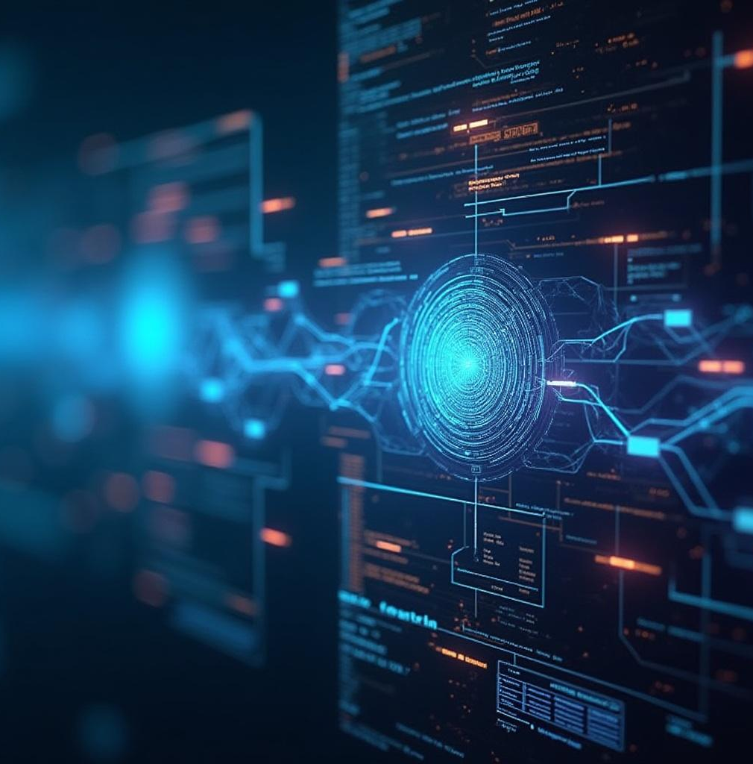
Classical machine learning feature extraction and evaluation
Extracts handcrafted statistical and texture descriptors (GLCM, LBP, wavelet-based and noise residual features) from scanned document images
Employs classical classifiers such as Support Vector Machines (SVM), Random Forest, and k-Nearest Neighbors (k-NN) for scanner source classification
Evaluates system performance using quantitative metrics including accuracy, precision, recall, F1-score, and confusion matrix
Serves as a baseline framework for comparative analysis with deep learning-based models
Demonstrates the limitations of manual feature engineering in capturing subtle scanner-specific artifacts

Slide 9
Deep learning with ResNet-18 architecture
Deep learning with ResNet-18 automates feature extraction by learning hierarchical noise representations directly from residual images. This model showed superior generalization and accuracy, effectively capturing subtle scanner artifacts and outperforming classical ML methods in identifying scanner sources.

Slide 10
AI Techniques and System Design
Uses Machine Learning and Deep Learning models for scanner classification
Extracts scanner-specific features from noise and texture patterns
Employs CNN architectures for accurate prediction
Integrates AI model into a web-based forensic analysis system

Slide 11
Explainable AI and web application deployment
Uses Explainable AI (Grad-CAM) to visualize model decision regions
Improves transparency and trust in AI predictions
Deployed as a web application for easy user interaction
Allows upload of scanned images and displays prediction results

Slide 12
Conclusions
- Scanner identification using AI is effective and reliable
- Scanner-specific noise patterns enable accurate source detection
- The system supports forensic investigations and document verification
- Provides a scalable and automated forensic solution

Slide 13
Future Work
Extend system to identify printers and cameras
Improve accuracy using larger datasets
Integrate cloud-based forensic services

Slide 14
Thank You

